Slide 1

Haley Ruth | Laura DeBoldt | Aishu Murari | Max Kern | Jingjing Bu
Notes:
Definitely explain : Seek = Sexual Education, Empowerment, and Knowledge

Slide 2
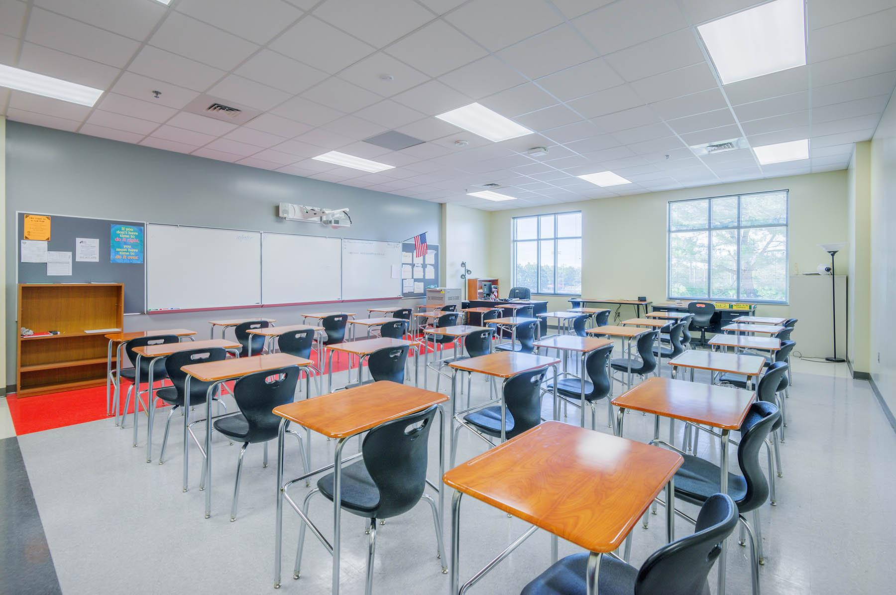
How helpful was your
sex education class in high school?

Slide 3
55% of 7th–12th graders say they have looked up health information online in order to learn more about an issue affecting themselves or someone they know.
[1] https://www.guttmacher.org/sites/default/files/pdfs/pubs/FB-Teen-Sex-Ed.pdf

Slide 4
Of web sites examined in a recent study, 46% of those addressing contraception and 35% of those addressing abortion contained
inaccurate information.
[1] https://www.guttmacher.org/sites/default/files/pdfs/pubs/FB-Teen-Sex-Ed.pdf

Slide 5
Overall Problem
Sex education in high school may be one of the most important classes students take because it applies to everyone.
However… sex ed courses are often inadequate, leading students to search on their own for answers.
This can lead to unsafe practices and the spread of misinformation among peer groups.

Slide 6
Problem: Consequence:
Course content seems irrelevant
or outdated
Disengage from class
Feel embarrassed or uncomfortable asking questions
Turn to potentially unreliable sources online for answers
Aren’t encouraged to explore
Perspective remains limited to quality of class content
Notes:
3. Perspective remains limited to quality of class material → if teacher is ill-prepared for teaching the subject, could be unhelpful for students who have serious questions about sex or who could benefit from learning about the diversity within sexual topics.

Slide 7

Design Research: Methods & Participants
Structured interview of...
three university students
one high school senior

Slide 8
Design Research: Takeaways
Students...
don’t feel comfortable asking questions in class
think a lot of material is not relevant to them
are not encouraged to seek outside information
distrust class material

Slide 9
Tasks
Communicating anonymously with teacher
Engaging in learning outside of class
Accessing credible resources and information
Exploring information relevant to oneself
Discussing course content with peers
Preparing to learn about each new topic

Slide 10
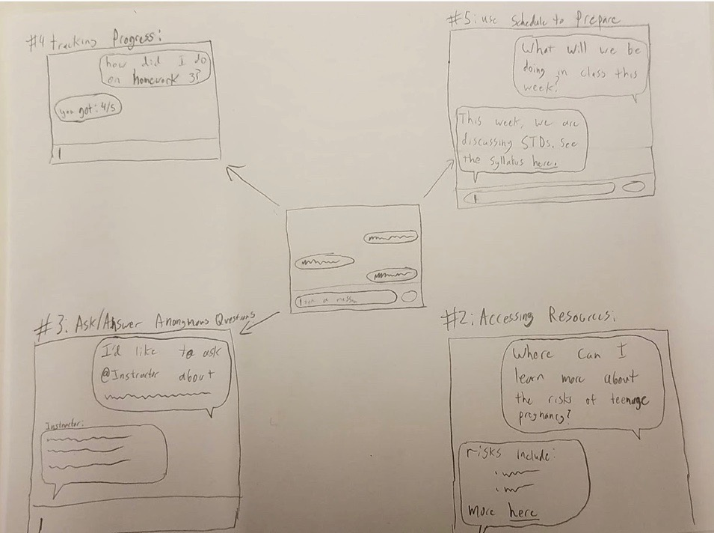
Design 1 - Chatbot

Slide 11
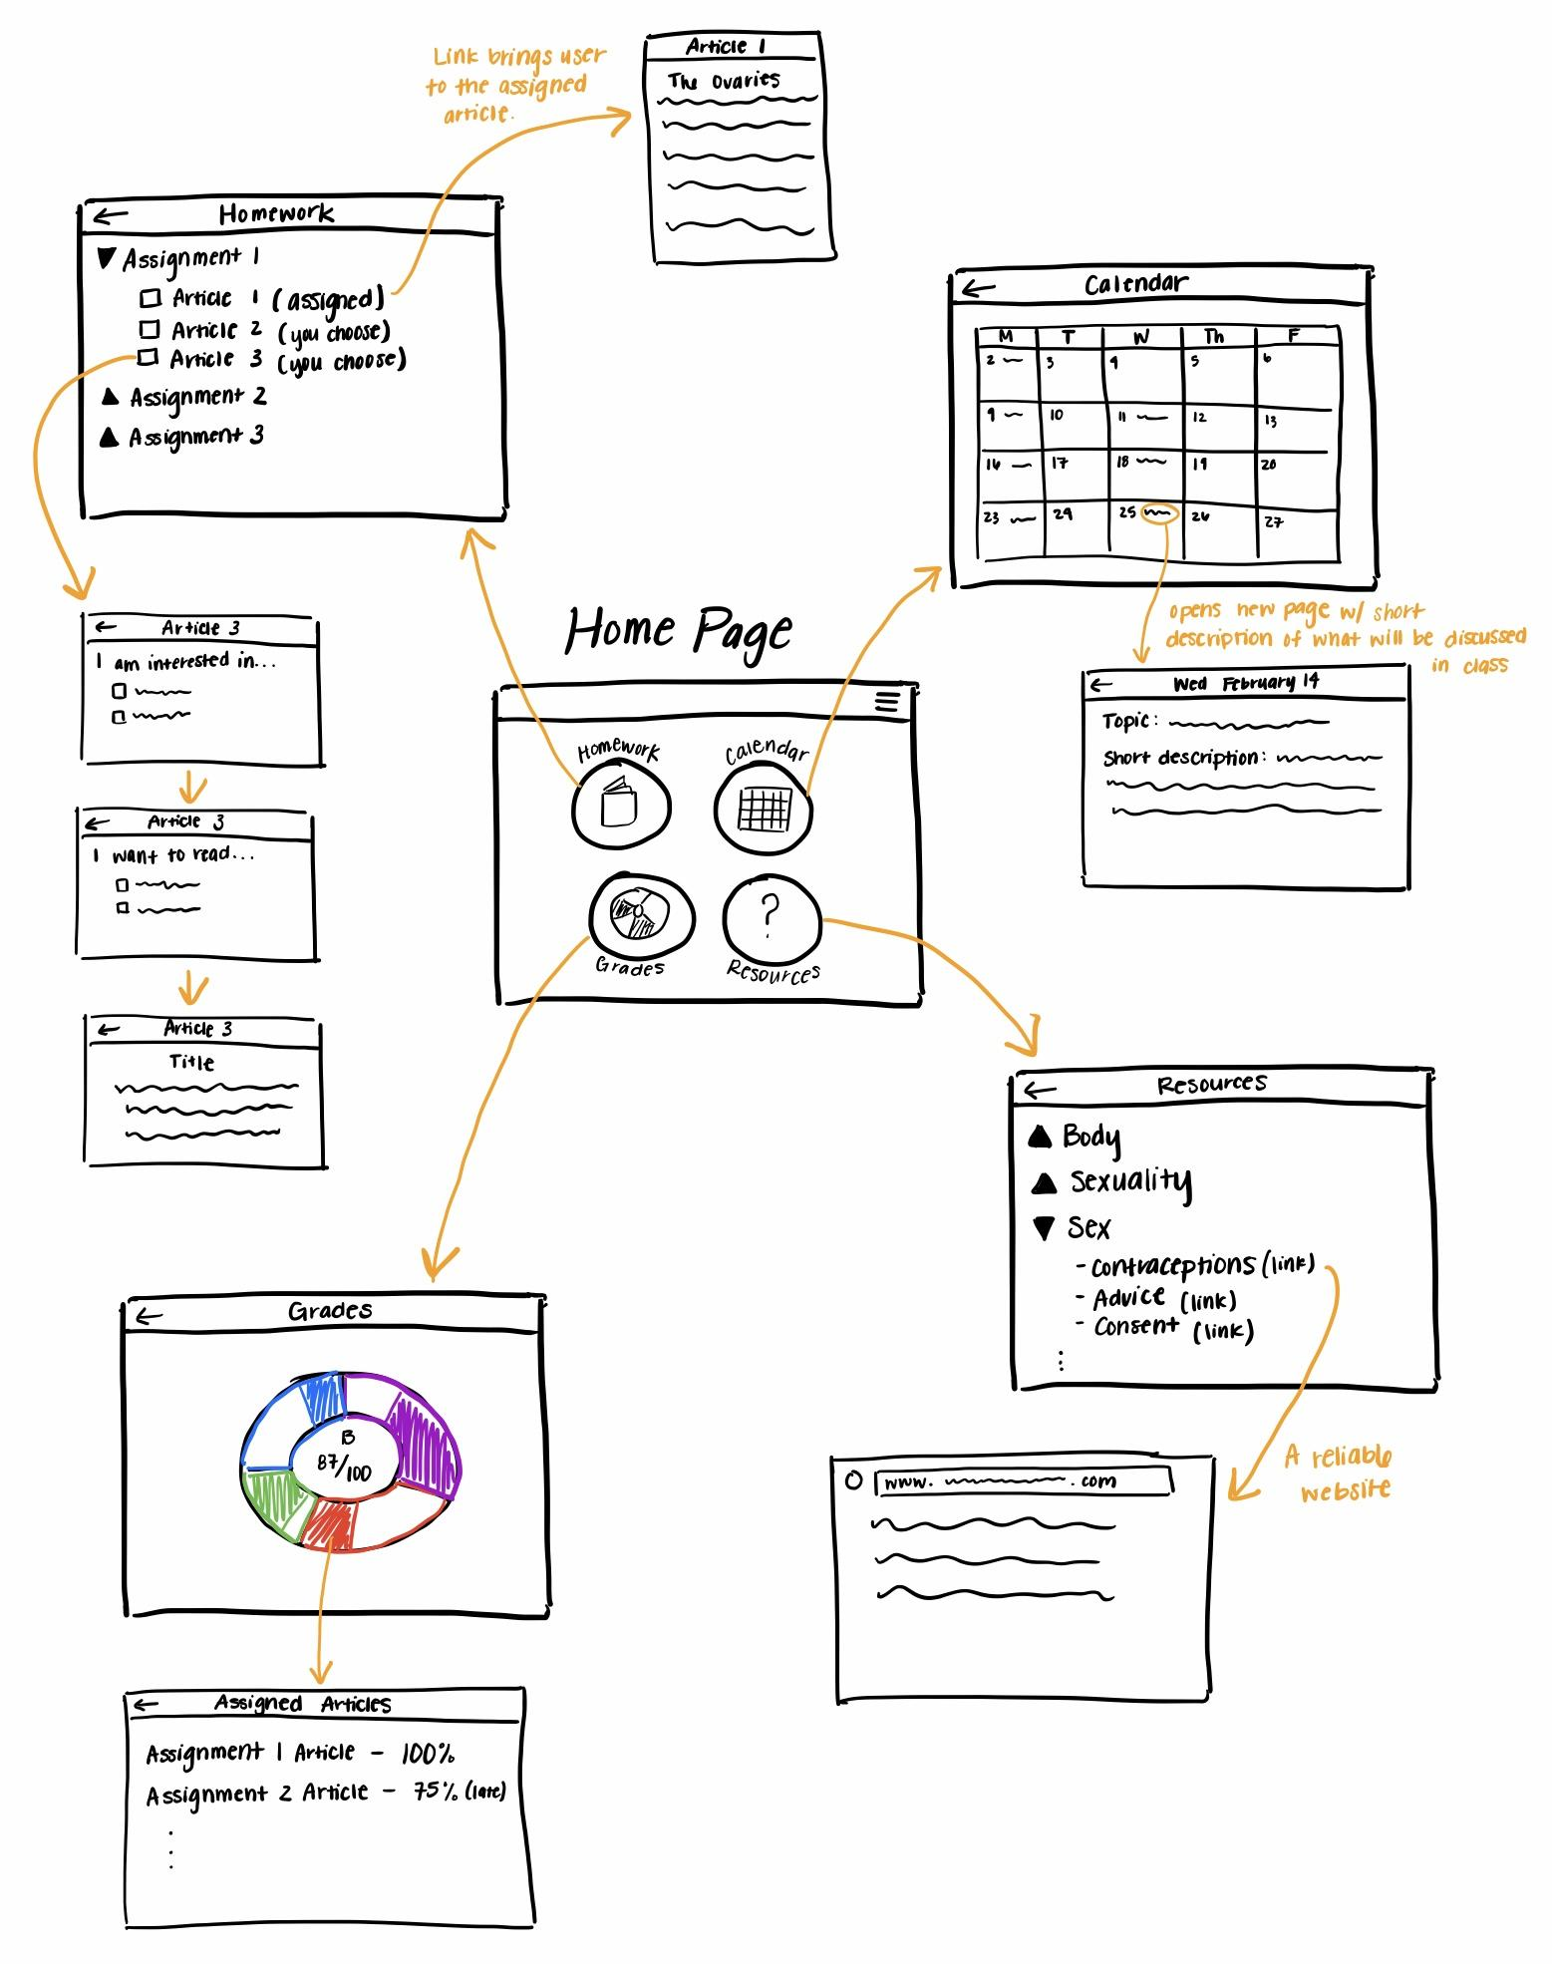
Design 2 - Course Management System

Slide 12
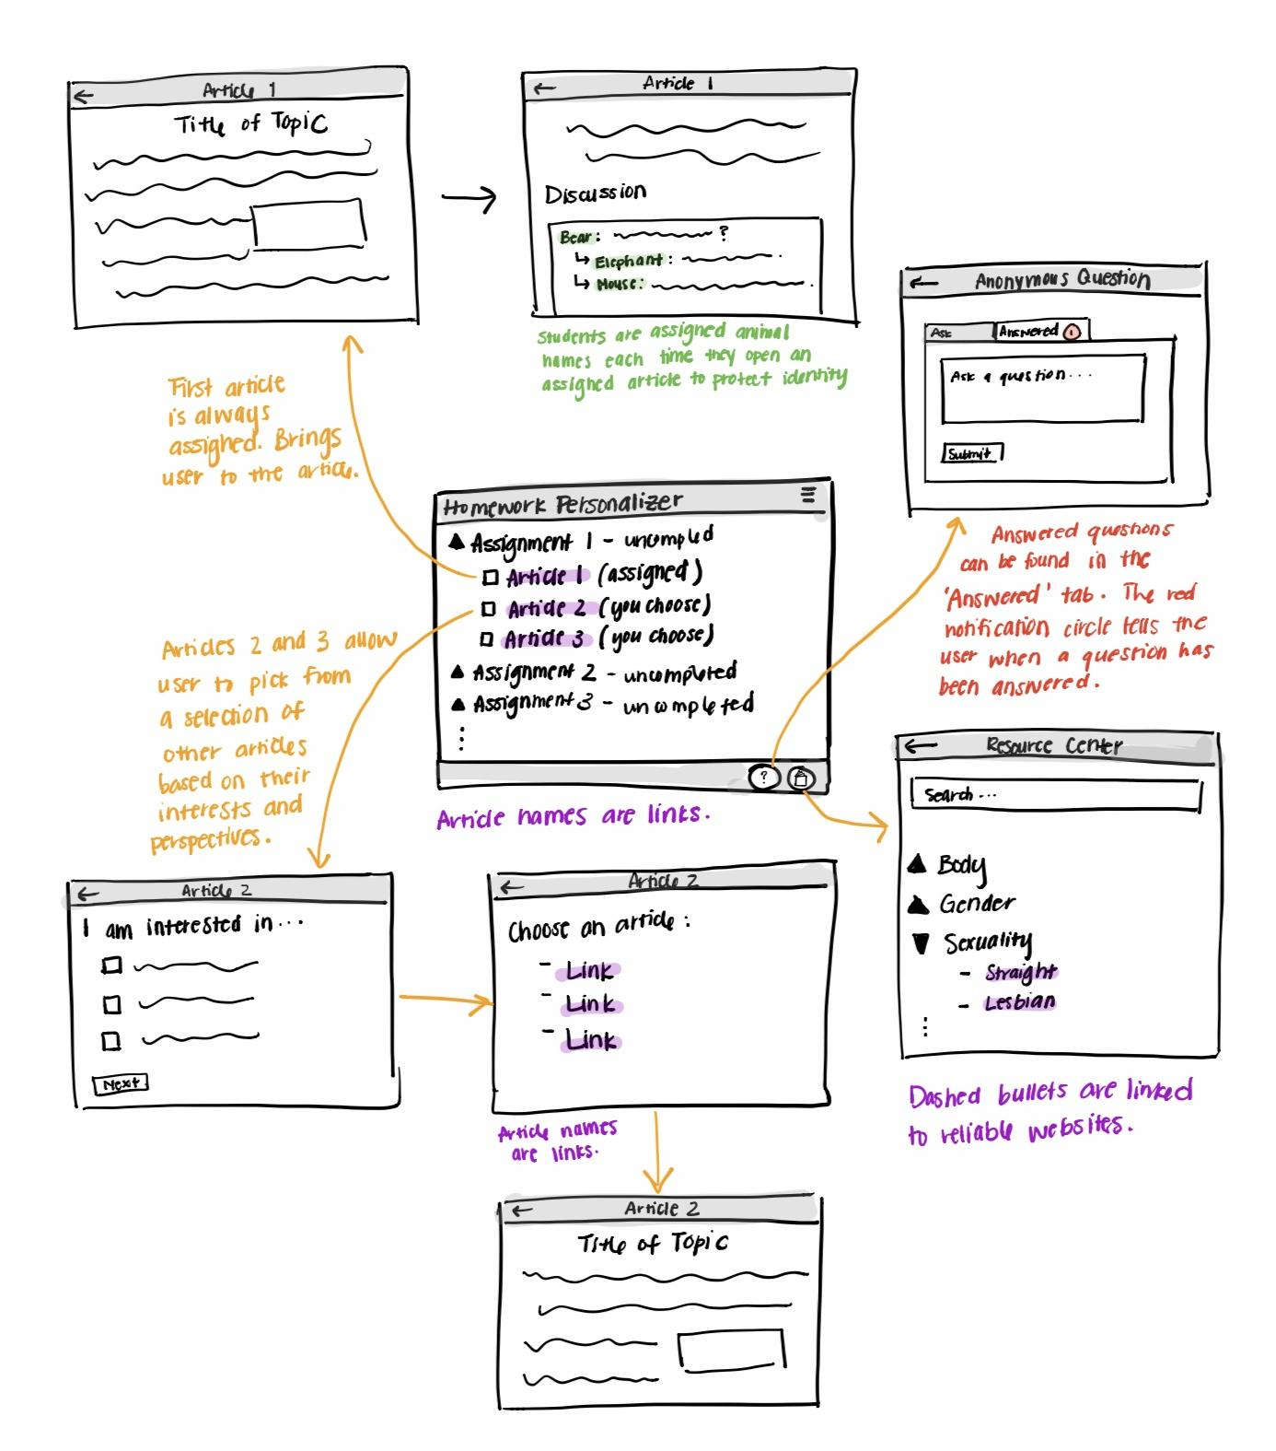
Design 3 - Tailored Interaction Tool

Slide 13
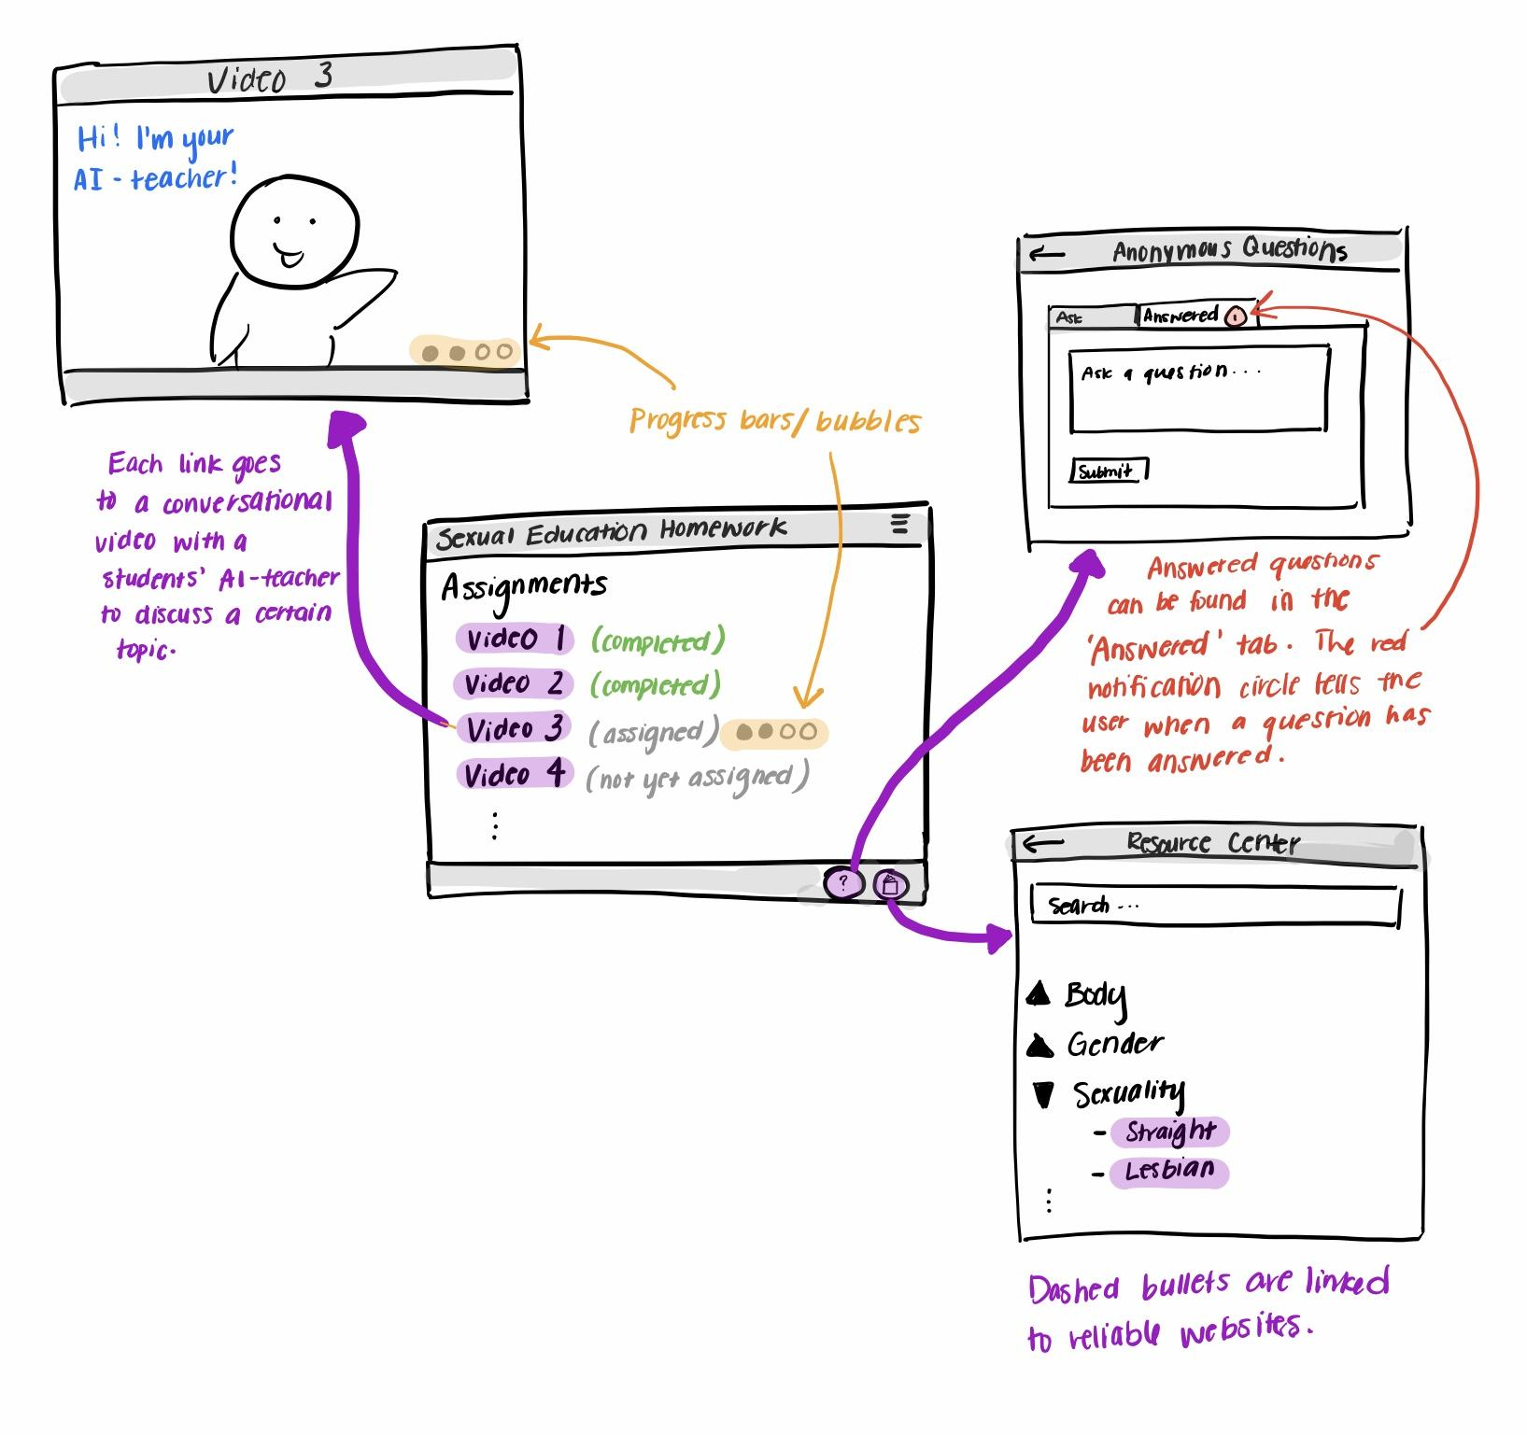
Final Design - AI Teacher

Slide 14
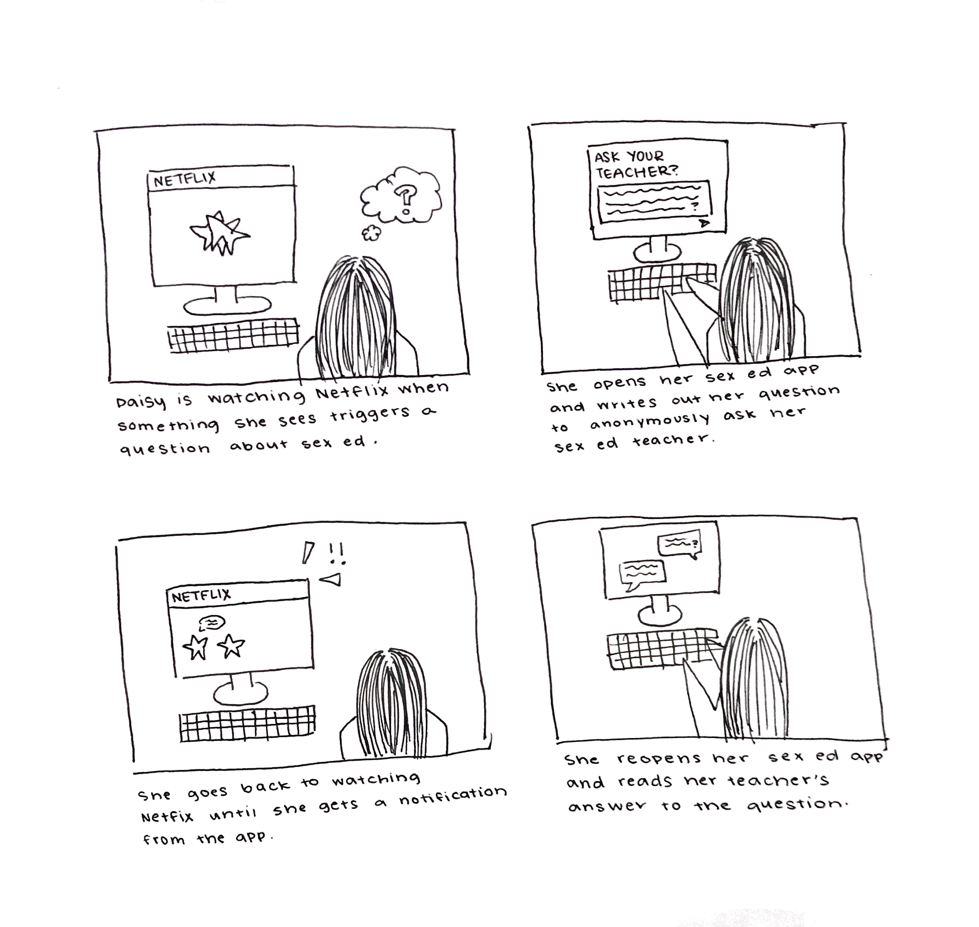
Storyboard 1
Enabling anonymous communication between students and teacher

Slide 15
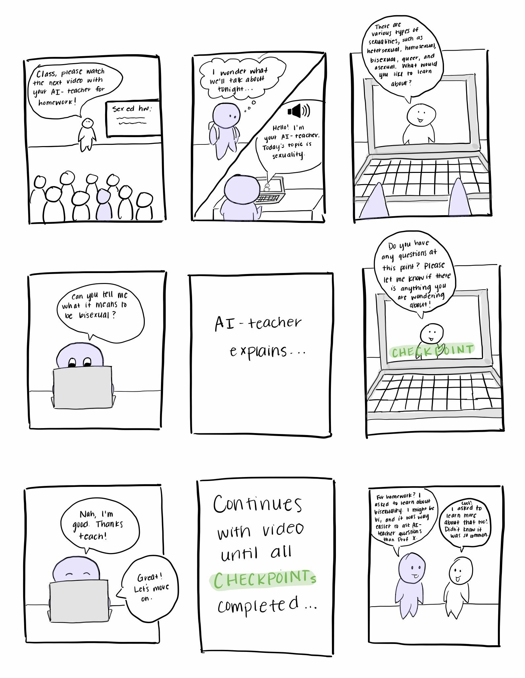
Storyboard 2
Making course more relevant to the individual by using AI to tailor content

Slide 16
Summary
Exploring ideas that don’t seem plausible can often lead to better ideas down the road (not a waste of time!)
Don’t be afraid to tackle a sensitive topic
Be willing to have your mind changed by feedback
Get out of the box and looking at various angles

Slide 17
Questions?

